Slide 1
Transpiration
Hi every one. You must have completed the work given to you by now. You check your answers on the following site.
https://www.topperlearning.com/selina-solutions/icse-class-10-biology/selina-concise-biology-part-ii/photosynthesis
Today we will deal with our next topic that is transpiration.
In std.8, we have learnt what is transpiration, factors
affecting the rate of transpiration and significance in short.
Let us elaborate the same topic further.
Transpiration is the loss of water in the form of water vapour from
the leaves and other aerial parts.

Slide 2
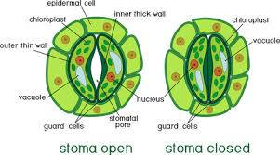
Structure of Stoma –open and close
Stomata are tiny openings on the surface of the leaf. Dicot plants have more stomata on the lower surface of the leaf while in monocot plants stomata are equally distributed on both upper and lower surfaces.
Refer the diagram 5.6 on page 58 for exam purpose. The diagram above is for reference.

Slide 3
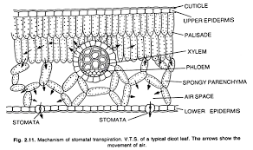
Kinds of Transpiration
1.Stomatal Transpiration-Takes through stomata
Mechanism of stomatal transpiration
The water from the xylem (in the center of the diagram)reaches to the surface of the mesophyll cells where there are lot of Intercellular spaces. Water evaporates and reaches to substomatal spaces and escapes through stomatal opening. More water escapes more is drawn from the veins. ( Role of imbibition and osmosis will be explained in the class)
Air space in the adjacent diagram is substomatal space.
As water keeps evaporating from leaves, more water is pulled from parts below via xylem
vessels. This is Transpiration Pull, the natural pump which is not visible , does not require any
energy source from outside but able to draw water up to 50 meters or even more in tall plants.

Slide 4
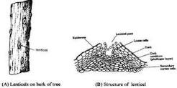
Types of transpiration continued..
2.Cuticular transpiration- takes place through the waxy layer on the
surface of the leaf. The main function of the cuticle is to prevent the
excess loss of water from the surface of the leaf. But evaporation takes
place when there is excess water in the plant and the conditions are
favourable for transpiration.
3. Lenticular transpiration-Lenticels are special openings on the bark of
the older stem.
This diagram of lenticel is not clear. Only to understand the exact location.
Not for drawing or labeling.

Slide 5
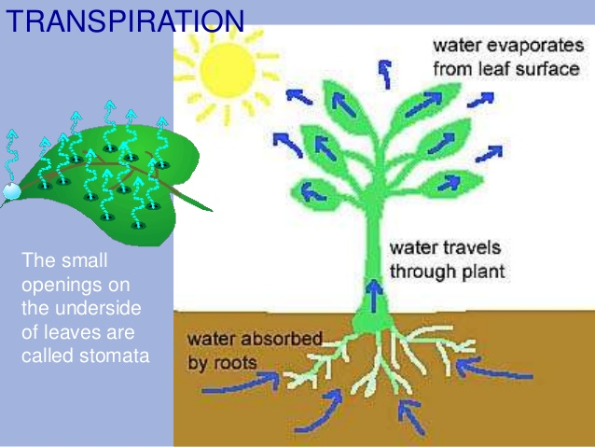
Topics for self study-Read and try to understand.
Factors that affect transpiration. 5.5 Page 60,61
Adaptations of plant to reduce transpiration. Page 61
Transpiration affects climate. 5.7.1Page 62
Difference between transpiration and evaporation. Table 5.1 Page 62
Difference between transpiration and guttation. Table 5.2 Page 64
Significance of transpiration.
1.Cooling effect-Transpiration reduces temperature
of the leaf surface as heat is drawn from the plant
same as perspiration helps animals to cool down in
hot weather.
2.Suction force- Will be taught in the class.
3.Distribution of water and mineral-More transpiration
pulls more water from the soil hence along with solutes.

Slide 6
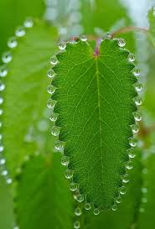
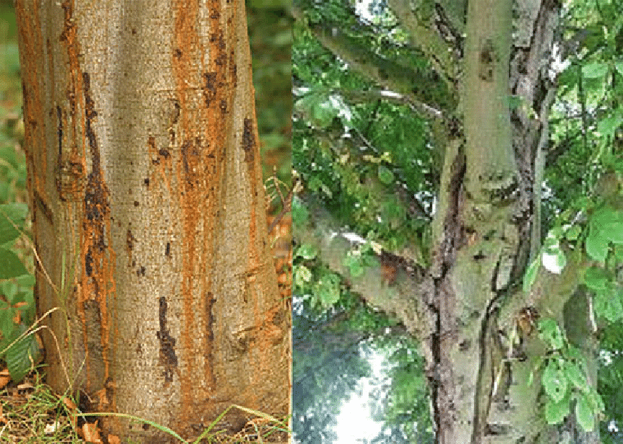
Guttation- The leaves of certain plants exhibit droplets of water along their margins in the mornings .The humid weather does not allow the transpiration to happen but roots keep absorbing water from the soil , this develops hydrostatic pressure and forces out the excess water from the tips of the veins through special openings called Hydathodes.
Bleeding- Cell sap escapes from the
ruptured or cut surfaces of plants.

Slide 7
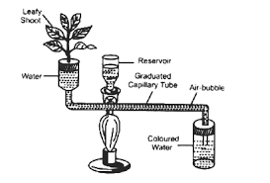
Experiments on Transpiration
Following experiments are part of our practical classes and will be explained during practical.
1. Aerial parts of the plants give out water vapour. Page 55,56
2. Loss of weight by the plant due to transpiration. Page 56,57
3. Unequal transpiration in dorsiventral leaf. Fig.5.9 Page 59
Ganong’s Potometer- The instrument helps to
measure water uptake by the plant as a result of transpiration. Potometer does not measure the water lost by transpiration as water absorbed by roots is used by the plant for some physiological activities like photosynthesis. Not all water absorbed by the roots of plant is transpired ,it is always less.

Slide 8
Home work to be completed in next SEVEN days.
Review Questions;
A Multiple Choice Type. With pencil on text book. (With pencil in the text book)
B. Very Short Answer Type. 1 and2 (With pencil in the text book)
C. Short Answer Type. 1,2,4 (With pencil in the text book)
D. Will be discussed in the class.
E. Will be discussed in the class.
Students, try to find out the answers for questions D and E.
Written work to be done in the notebook.
B. Very Short Answer Type. Give suitable explanation for the following.
Differentiate between the following terms based on the clue given in the bracket.
Transpiration and Guttation. ( Structures involved in the process)
Stomatal and Lenticular transpiration. (Duration of the process)
Evaporation and Transpiration. ( Type of factors which control the process)

